Slide 1
Linear Algebra
Lecture 17

Slide 2
Segment III

Slide 3
Determinants

Slide 4
Introduction to
Determinants

Slide 5
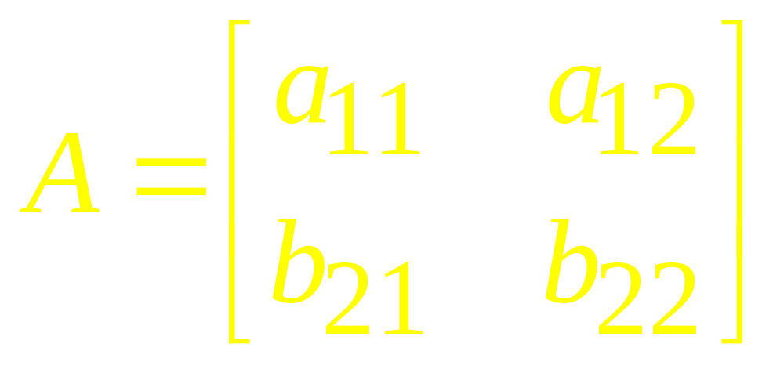
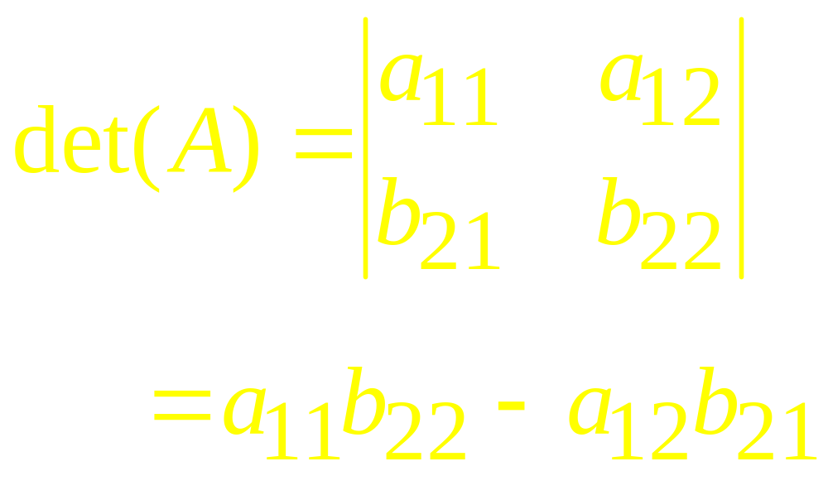
2 x 2 Determinant

Slide 6
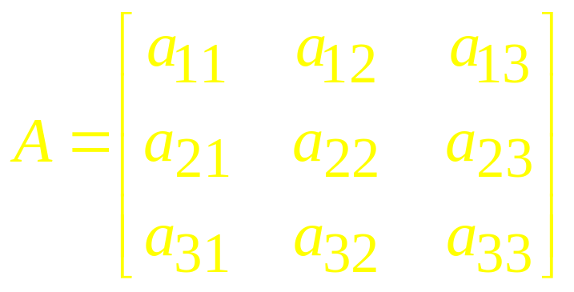
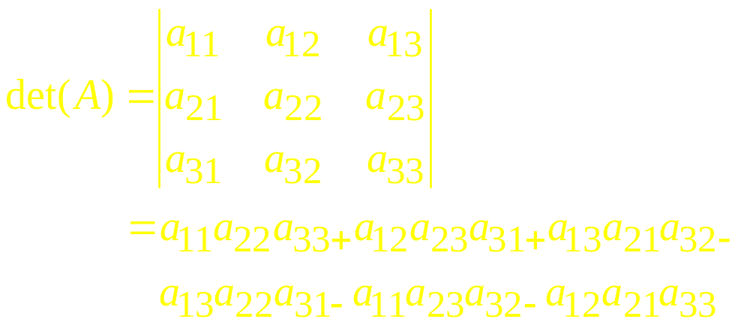
3 x 3 Determinant

Slide 7

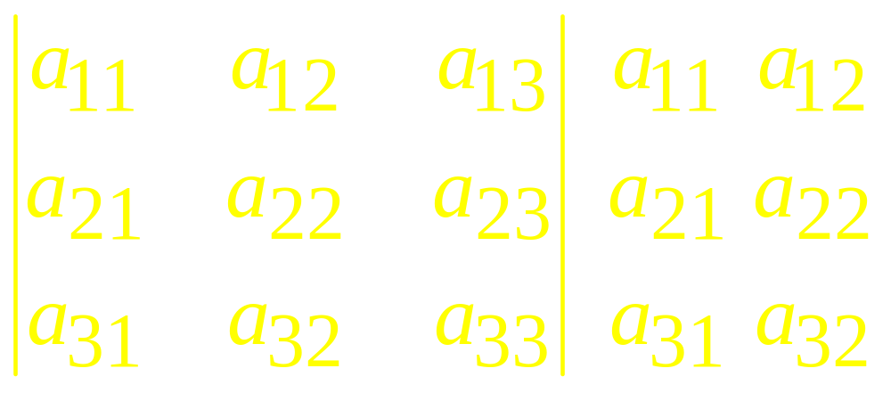


Or it can be expressed as

Slide 8
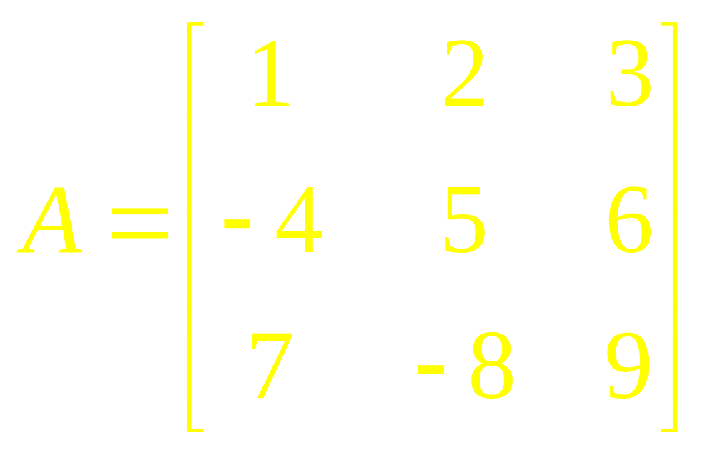
Example 1
Find the determinant of the matrix.

Slide 9
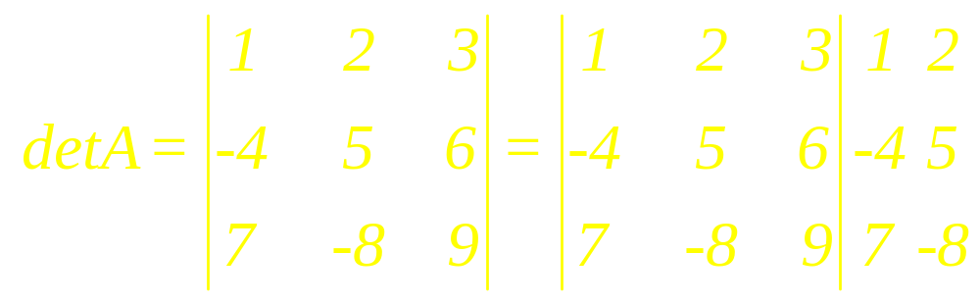
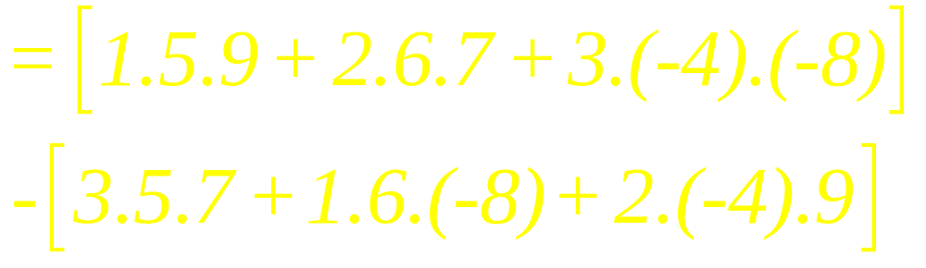
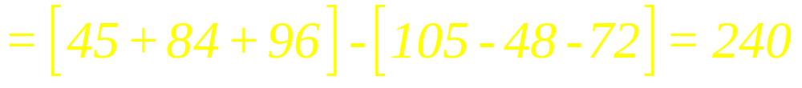
Solution

Slide 10
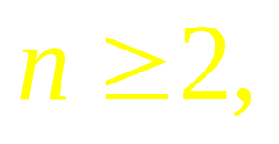
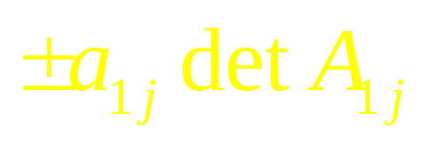
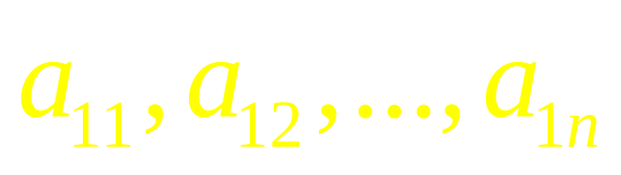
Definition
For the determinant of n x n matrix A is the sum of n terms of the form , with plus and minus signs alternating, where the entries
are from the first row of A.

Slide 11
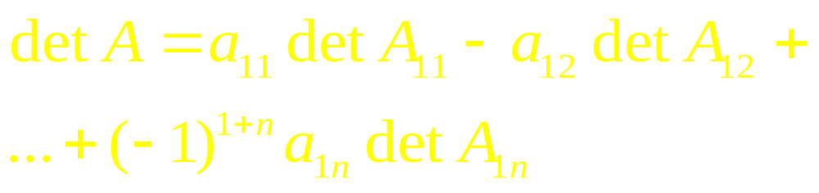
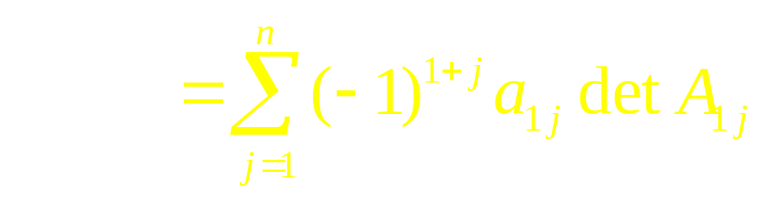
OR in Symbols

Slide 12
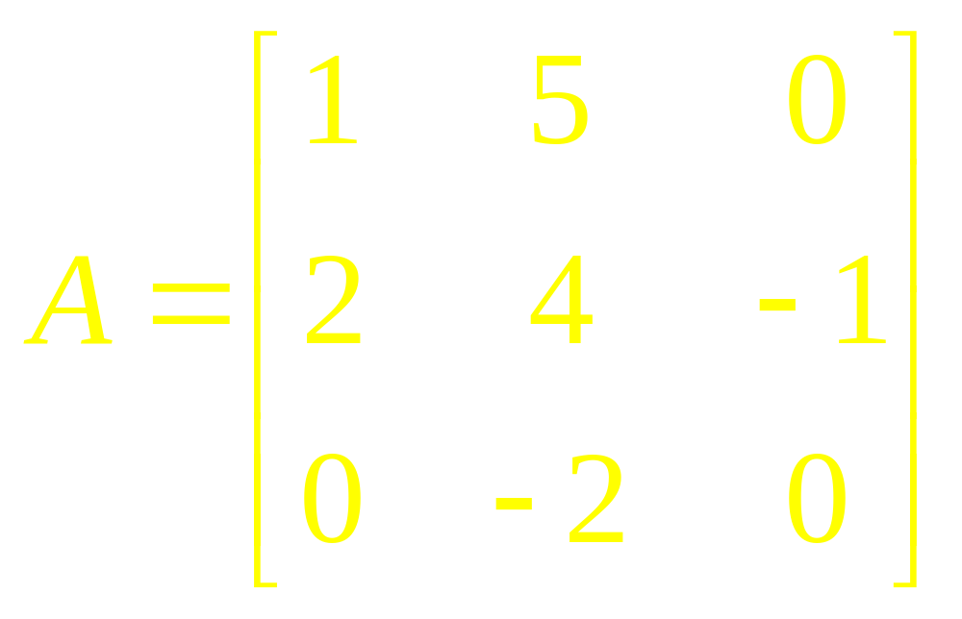
Example 2
Compute the determinant of

Slide 13
Minor of a Matrix
If A is a square matrix, then the Minor of entry a_{ij} (called the ijth minor of A) is denoted by M_{ij} and is defined to be the determinant of the sub matrix that remains when the ith row and jth column of A are deleted.

Slide 14
Cofactor
The number
C_{ij}=(-1)^{i+j} M_{ij}
is called the cofactor
of entry a_{ij}
(or the ijth cofactor of A).

Slide 15
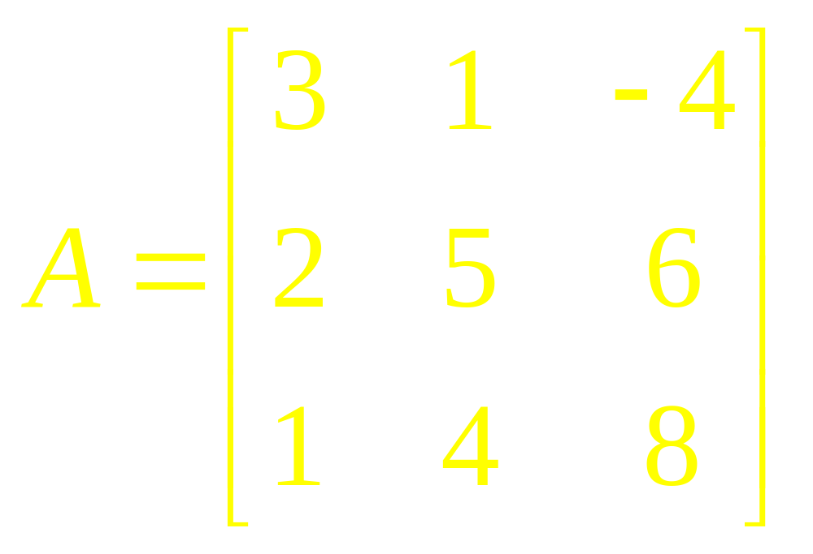
Example 3
Find the minor and cofactor of the matrix.

Slide 16


Cofactor Expansion Across the First Row

Slide 17
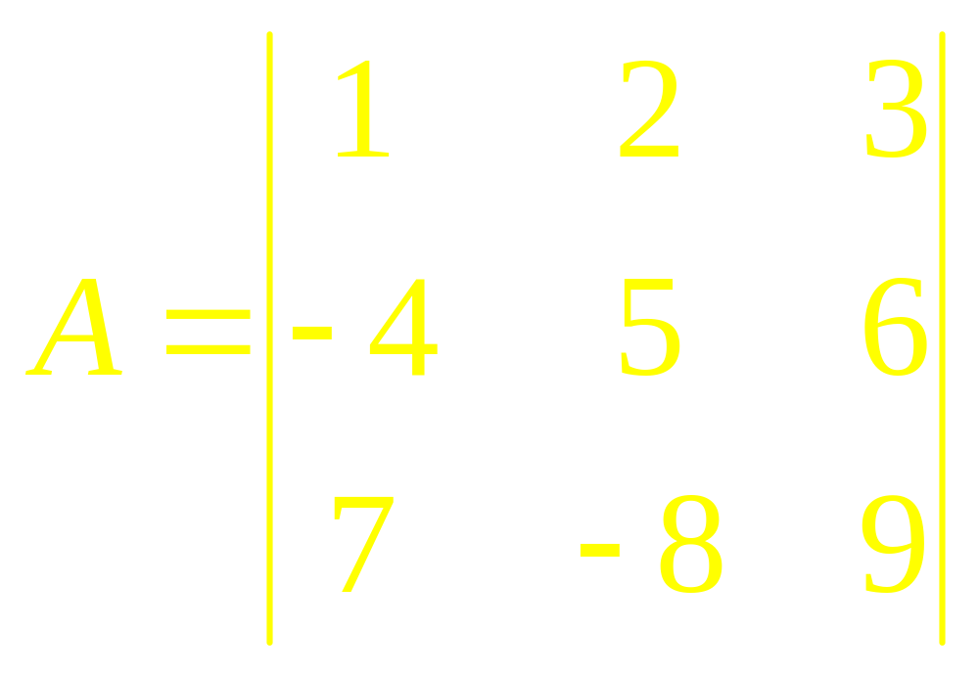
Example 4
Expand a 3x3 determinant using cofactor concept

Slide 18
Theorem
The determinant of a matrix A can be computed by a cofactor expansion across any row or down any column.

Slide 19


The cofactor expansion across the ith row
The cofactor expansion down the jth column

Slide 20
Example 5
Use a cofactor expansion across the third row to compute det A, where

Slide 21
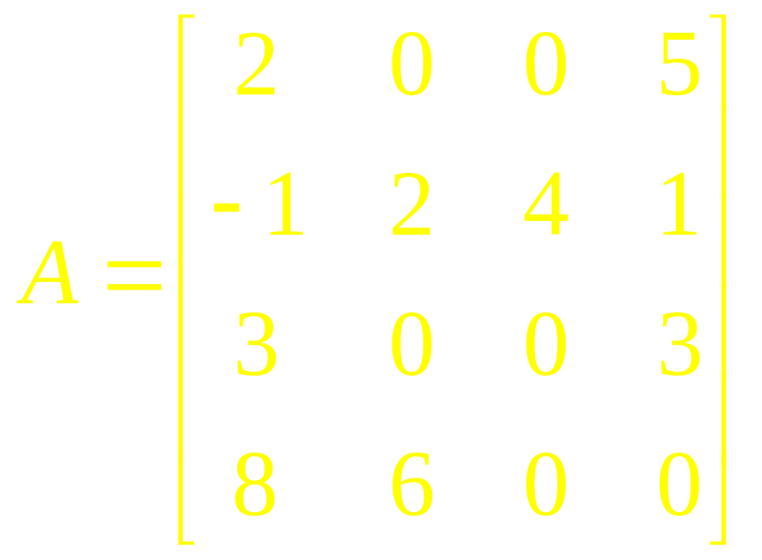
Example 6
Evaluate the determinant of

Slide 22

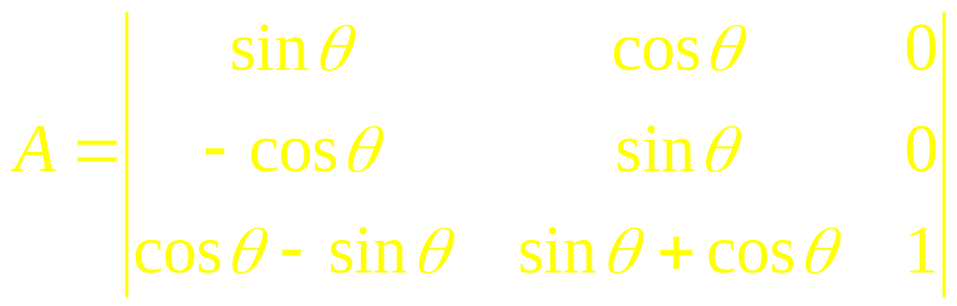
Example 7
Show that the value of the determinant is independent of

Slide 23
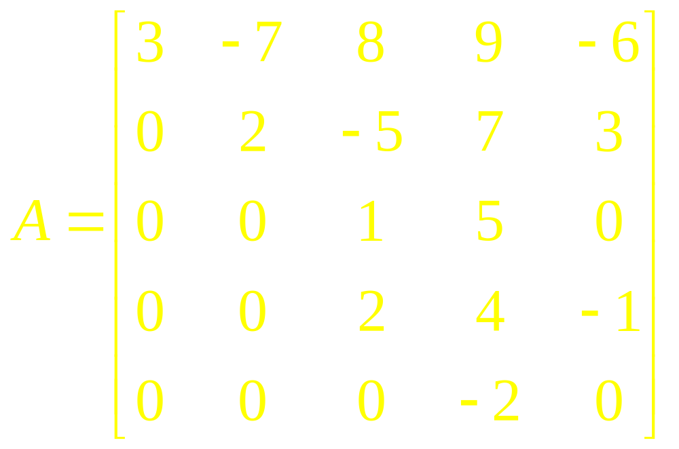
Example 8
Compute det A, where

Slide 24
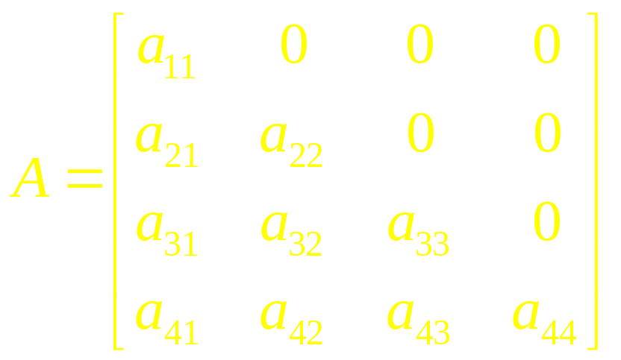
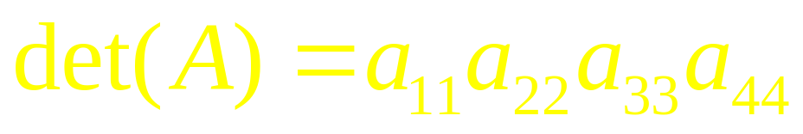
Theorem
If A is triangular matrix, then det (A) is the product of the entries on the main diagonal.

Slide 25
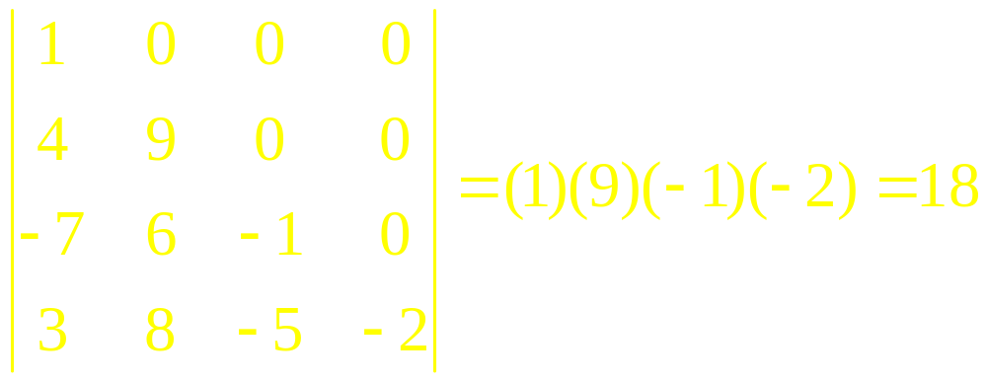
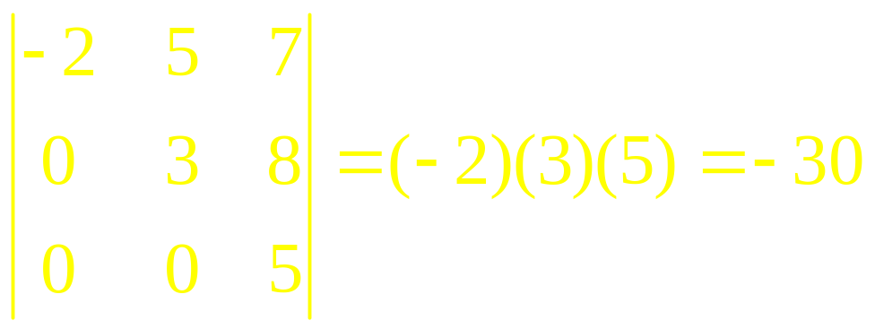
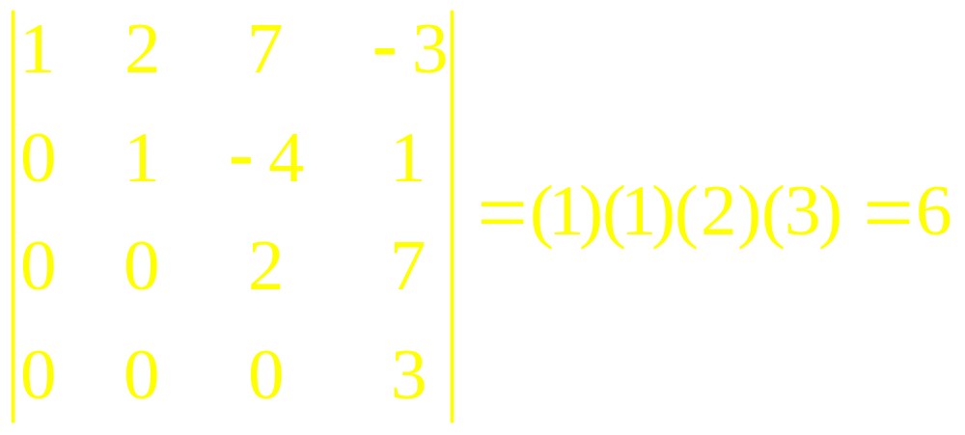
Example 9

Slide 26
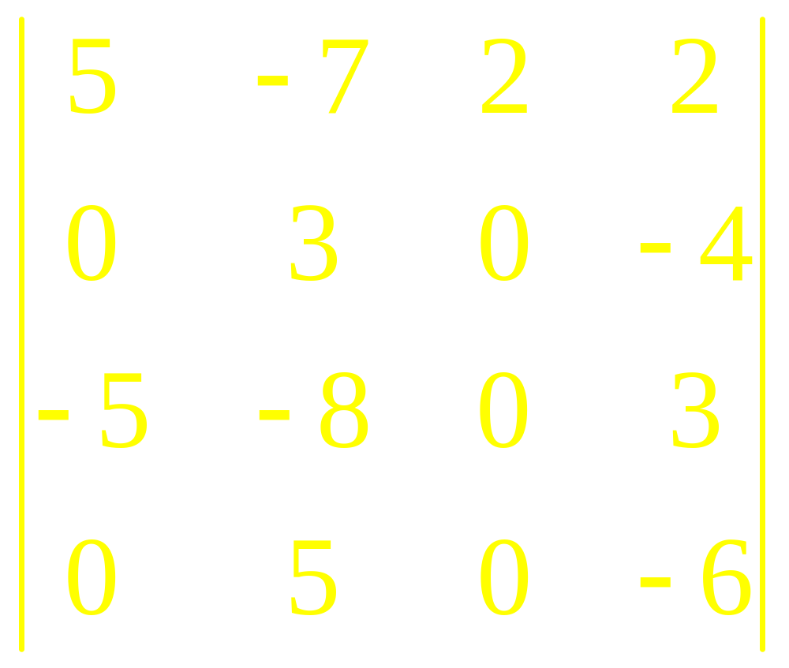
Example 10
Compute

Slide 27
Linear Algebra
Lecture 17

